Slide 1
Big Data
Programmatic Governance
Rui Zhang
2016 Summer Intern Demo
Notes:
Big data has been increasingly popular since the amount of data that we dealt with is huge.

Slide 2
Apache Kafka
What is Kafka?
---Distributed, partitioned, replicated commit log service/messaging system
Why Kafka?
---Fast, scalable, durable
Notes:
Fast --- can handle hundreds of megabytes of reads and writes per second from thousands of clients.
Scalable --- It can be elastically and transparently expanded without downtime.
Durable --- Messages are persisted on disk and replicated within the cluster to prevent data loss
Lots of teams here at HomeAway produce and consume messages from the Kafka clusters

Slide 3
Topic
Kakfa maintain feeds of messages in categories called topics
High-level abstraction

Slide 4
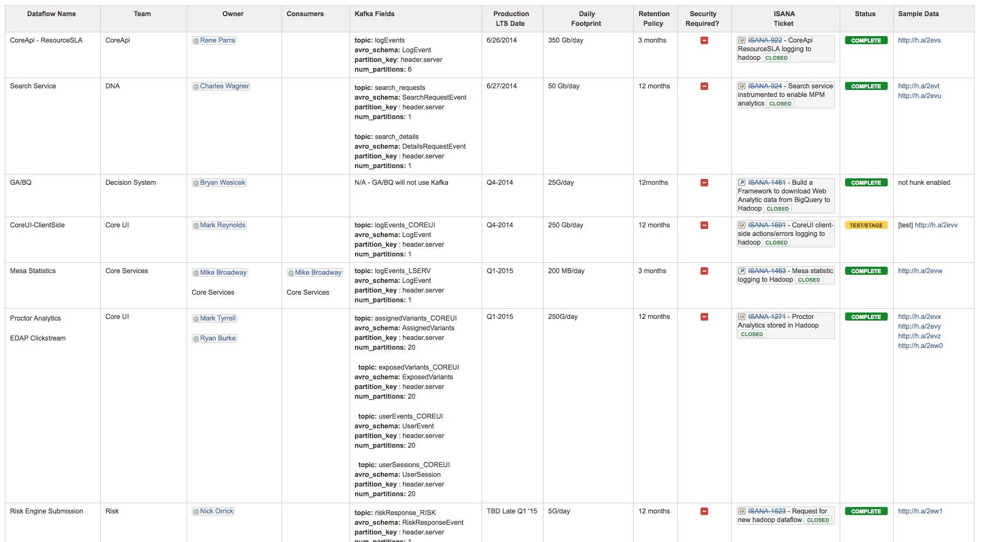
Historically at HomeAway...
Notes:
Historically, a wiki page has been used to define and keep track of data flows across our Big Data infrastructure. The problem with using this is that the wiki page can deviate from the actual data flows that live in production systems.
AND if people want to update the cluster, the changes will not take place immediately -- it will require human effort to make the changes

Slide 5
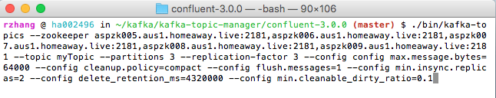
Then to Create a new topic manually...
Get the Kafka project source code or Confluent.io
Test the connection to the cluster

Slide 6
What’s the problem?
No single source of truth
2. Manual interaction introduces configuration drift
3. Too much repetitive work -- no automation
4. Low durability
5. Effort to learn/configure the cluster

Slide 7
What we want instead ???
Automated process
Programmatic topic configuration
Infrastructure as code
Centralized repo for topic configuration
Auditability and validation of config values

Slide 8
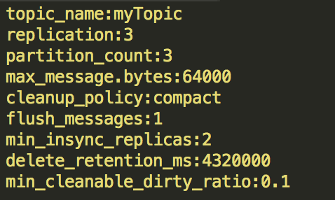
Right now… NO terminal NO connection NO download
JUST
WHAT
YOU
WANT
One-to-one mapping: File ←→ topic

Slide 9
The design decision
We used Github as our file system
PR → approved → repo changed → cluster automatically updated
OR
PR → not approved → repo not changed → nothing happened
User’s perspective: PR merged or not → success or failure
Note: Moving forward, we are going to automate the PR merge

Slide 10
Desired Status VS Actual Status
Topic as code VS Manual interaction
My application → The green bridge
Give our users what they want!

Slide 11
The workflow
→ TeamCity will pull down my application
→ TeamCity will pull down the Kafka topics repo once there is a change
→ Run the application to automatically update the cluster
The main takeaway:
People are only dealing with code → automated updates

Slide 12
Other notes...
Configuration
Initialization
Overriding existing files
Logging
Error checking/validation

Slide 13
Kafka Topic Viewer
What’s on the cluster?
Is the cluster in synchronization with the files?

Slide 14
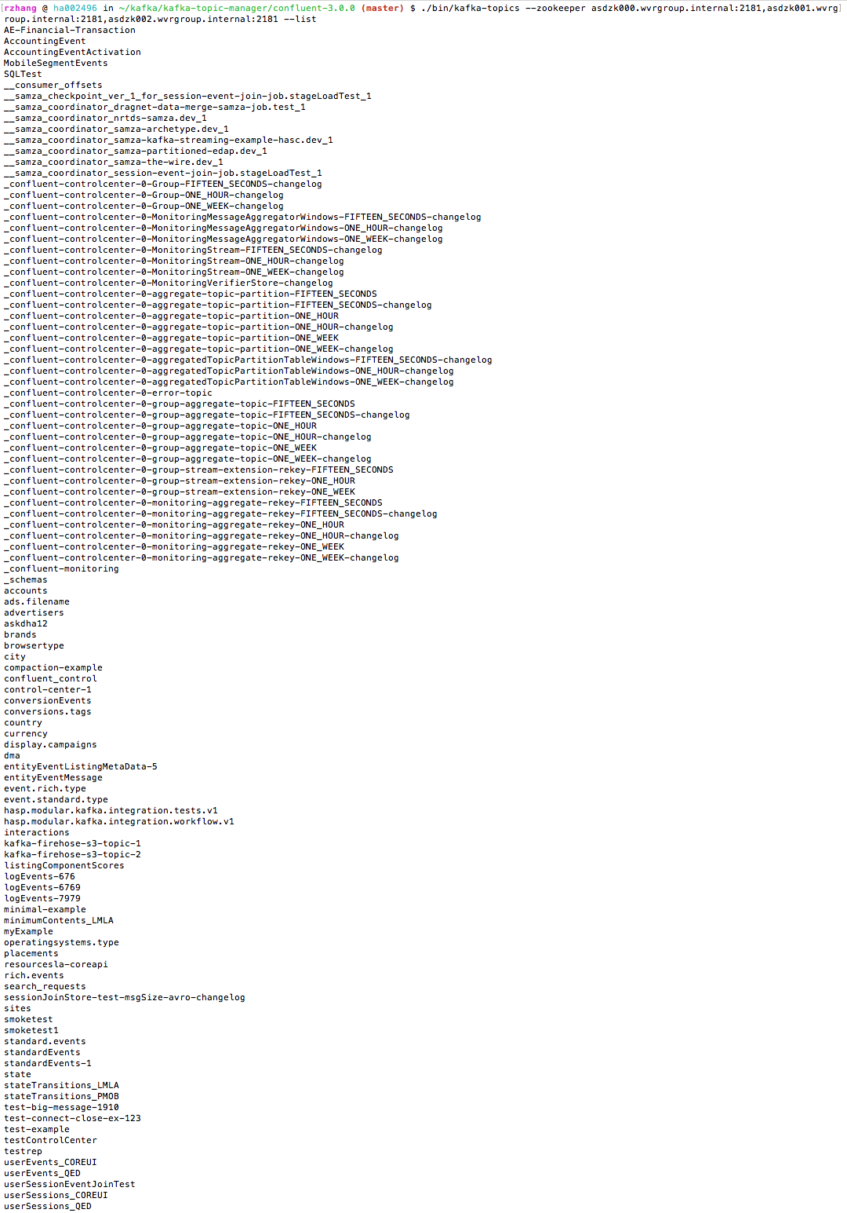
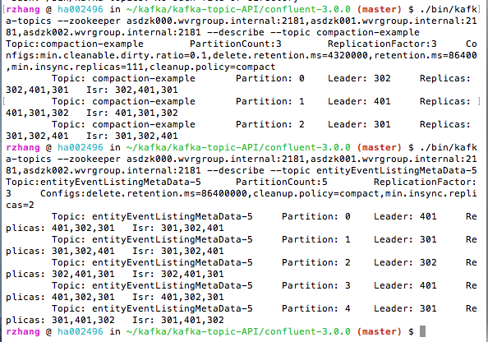
The old way:
To view all topics
To view a topic

Slide 15
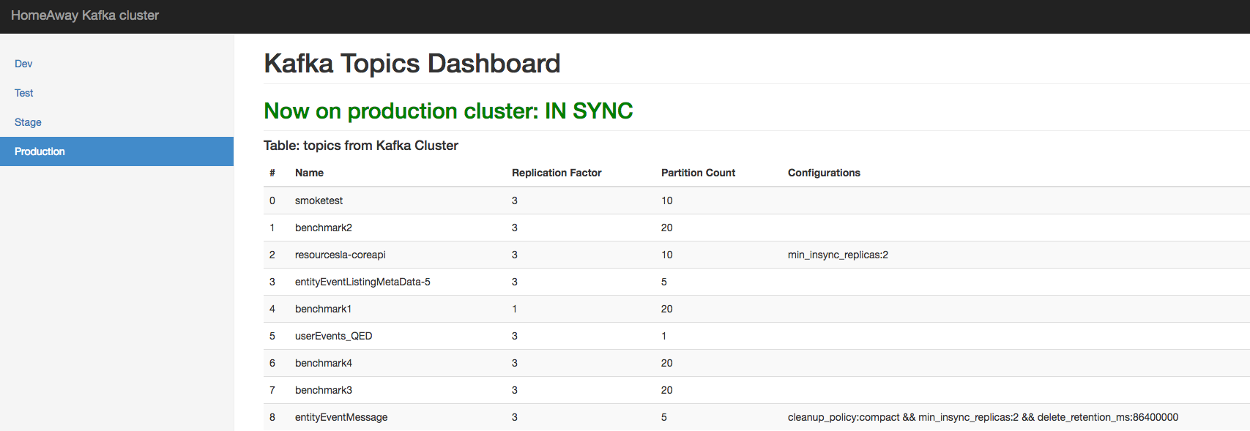
With the Kafka topic viewer...
Current status of the cluster
All clusters
A list of all the topics

Slide 16
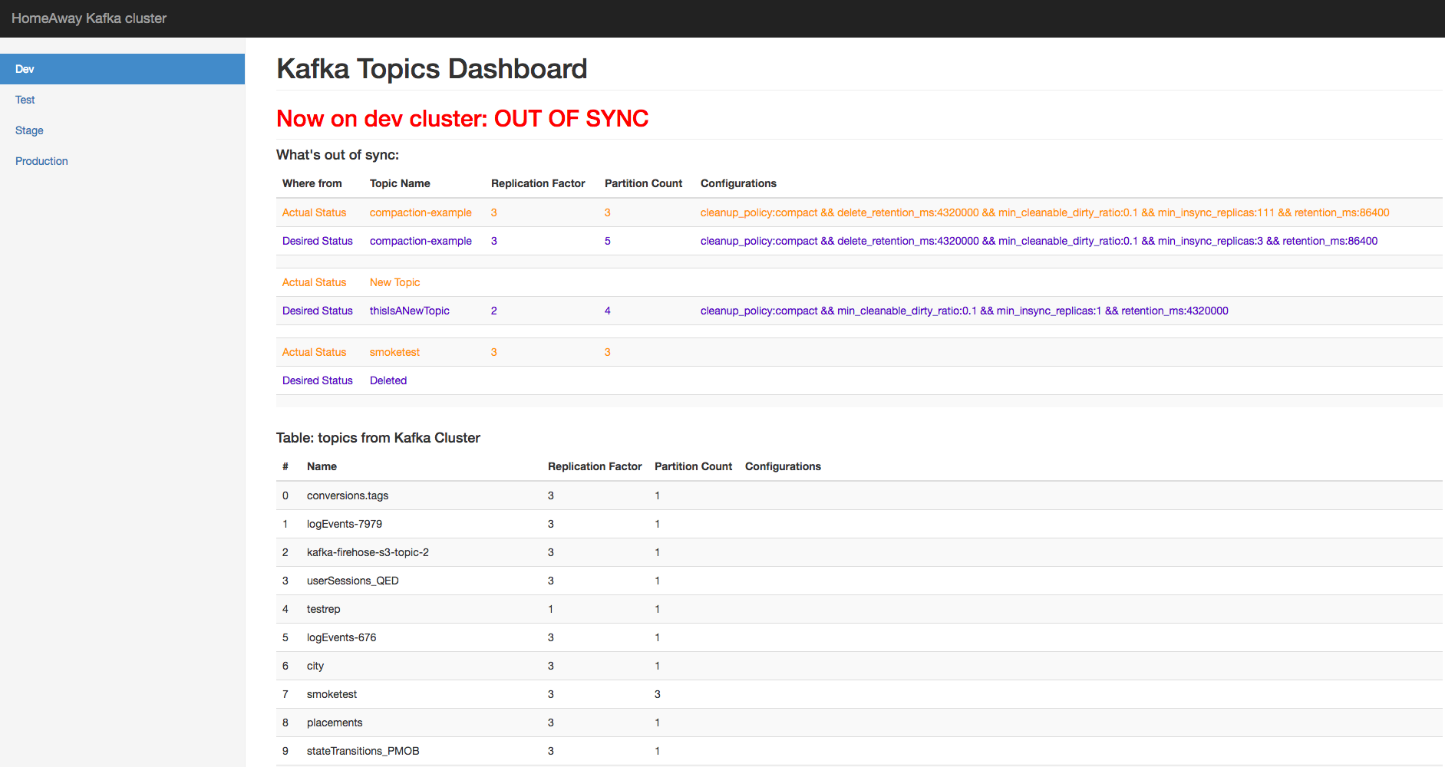

Slide 17
?

